Slide 1
faithbook
Presented by the Youth of
Ss. Peter and Paul Orthodox Church
Manville, NJ

Slide 2
Everybody is on social media these days - kids, adults, even people who grew up with a radio for their entertainment, use social media. Facebook, Twitter, Snapchat, Instagram. Every day there’s a new way to connect. Sometimes it’s used for good purposes – keeping in touch, sharing information, sending something funny to friends who could use a good laugh. Other times it’s used for negative purposes, but that’s a discussion for another day.
Today, we’re presenting our newest social media platform:
faithbook, for Orthodox Christians.
Sarah

Slide 3
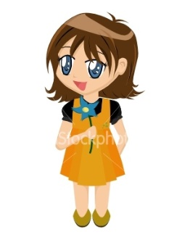
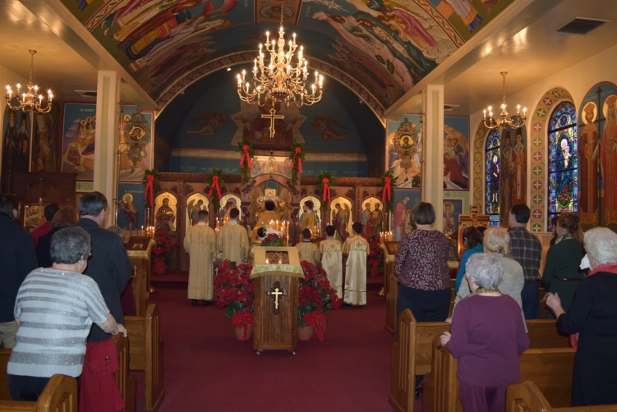
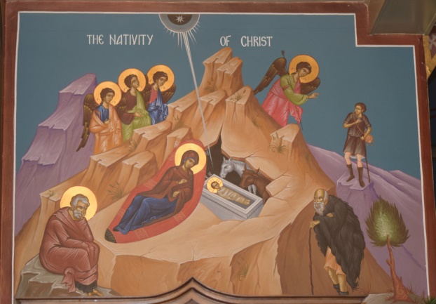
Sophia
Ss. Peter and Paul Orthodox Church is So Beautiful at Christmas!
My family and I were at church services for the feast of the Nativity and it was really nice. The Nativity Icons were out, there were pointsettas all over the church and the choir sang the festal hymns.
Ava
There were a lot of people in church on Christmas! I like to see everyone!
Adi
I’m glad that Deacon Paul explained the icon. I learned so much! The whole story is right there!

Slide 4
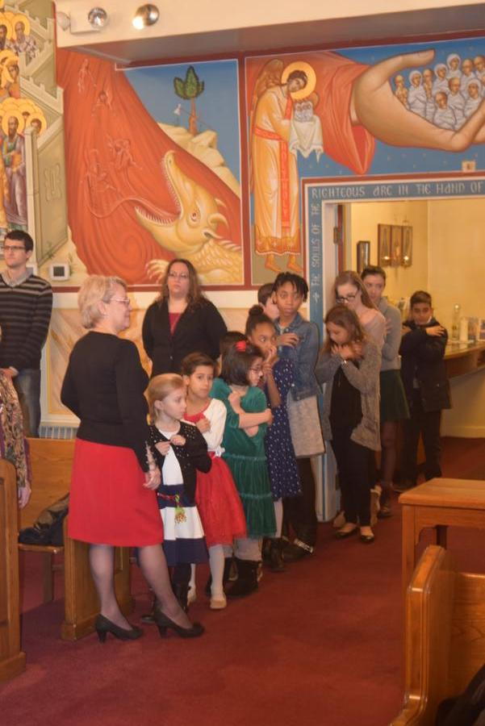
Alex
I can’t imagine NOT going to church on Christmas! How do people celebrate Christmas without Christ anyway???? I mean, isn’t that the whole reason that we have this feast day?
I thought that it was really great to see all of my church friends dressed so pretty and bright and receiving Communion.
I feel good telling people, “Christ is Born!” and then hearing them say, “Glorify Him!”

Slide 5
Troparion of the Nativity
Thy Nativity, O Christ our God
Has shone to the world the light of wisdom!
For by it, those who worshipped the stars
Were taught by a star to adore Thee,
The Sun of Righteousness,
And to know Thee the Orient from on high,
O Lord, Glory to Thee!

Slide 6
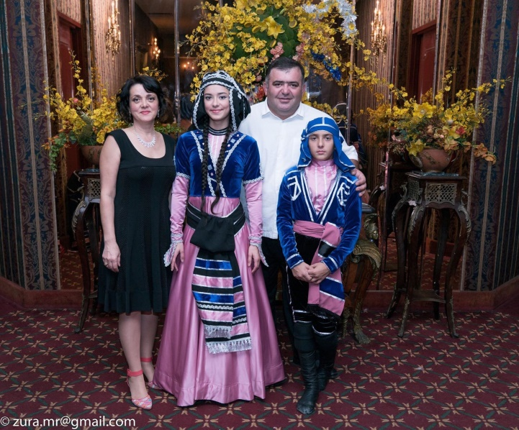
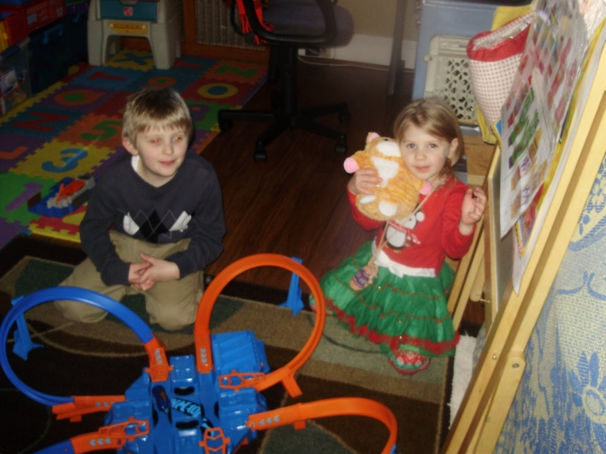
Sophia
Christmas is my FAVORITE holiday! I love when my family is all together, our house is decorated so nice, t here’s a lot of good food, and it’s fun to give presents to all of the people that we love!
Saba
In our family, we have a lot of traditions from Georgia. I’m glad that we keep up with these and sometimes we get to share them with others.
Constantine
We had so much fun on Christmas! Our family always tries to make it a special day!

Slide 7
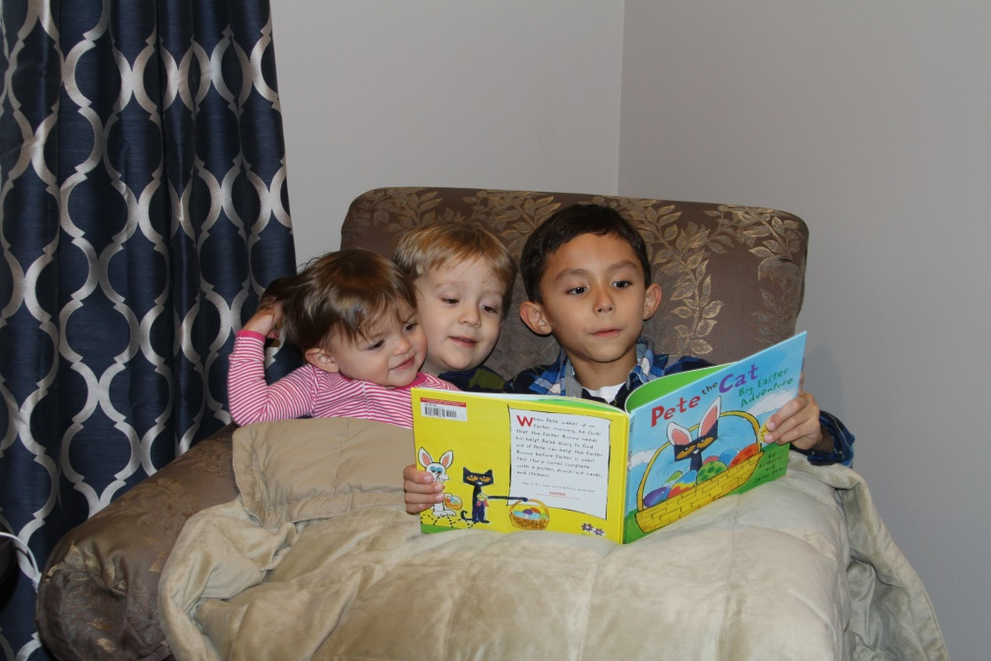
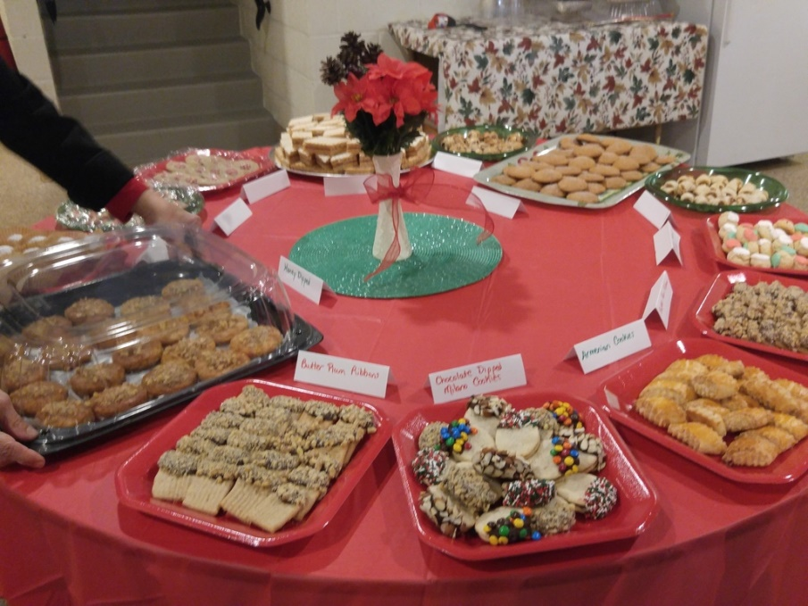
Nicholas
I got to spend time with my cousins, Austin and Brielle, over the holidays. I had fun reading a book to them. They like “Pete the Cat”.
Christos
Cookies, cookies, cookies. Can’t we just have more cookies during the year? Why is it just at Christmas?!? I love cookies!

Slide 8
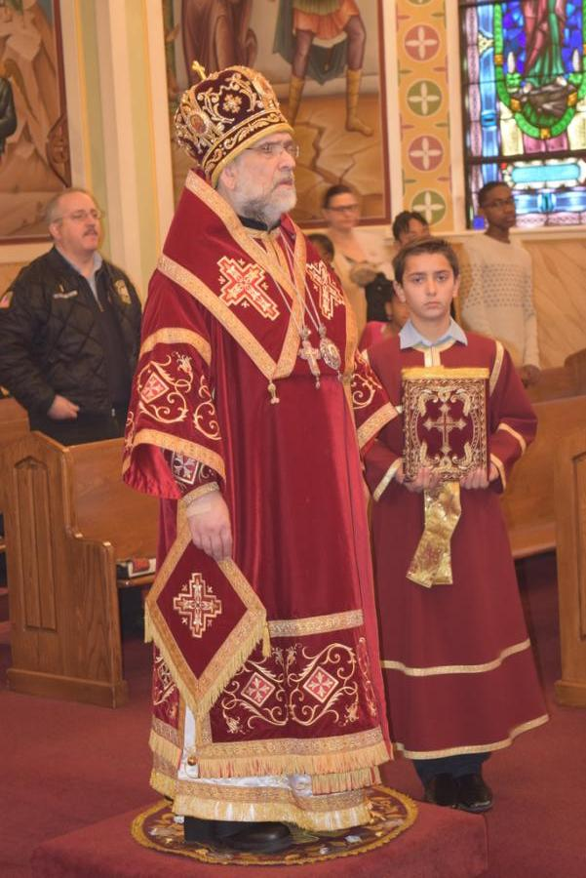
Hark! the Herald Angels Sing
Hark! the herald angels sing,
“Glory to the new born King!”
Peace on earth and mercy mild
God and sinners reconciled.
Joyful, all ye nations rise,
Join the triumph of the skies
With angelic host proclaim,
“Christ is born in Bethlehem!”
Hark! the herald angels sing,
“Glory to the new born King!”

Slide 9
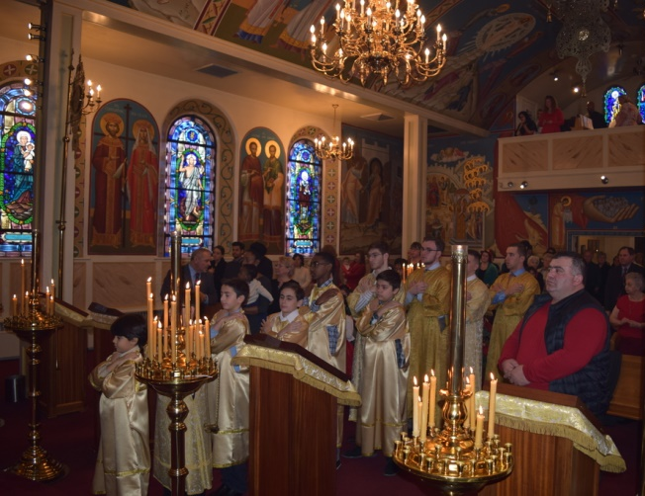
Away in a Manger
Away in a manger, no crib for a bed,
The little Lord Jesus lay down his sweet head.
The stars in the sky look down where He lay
The little Lord Jesus asleep on the hay.

Slide 10
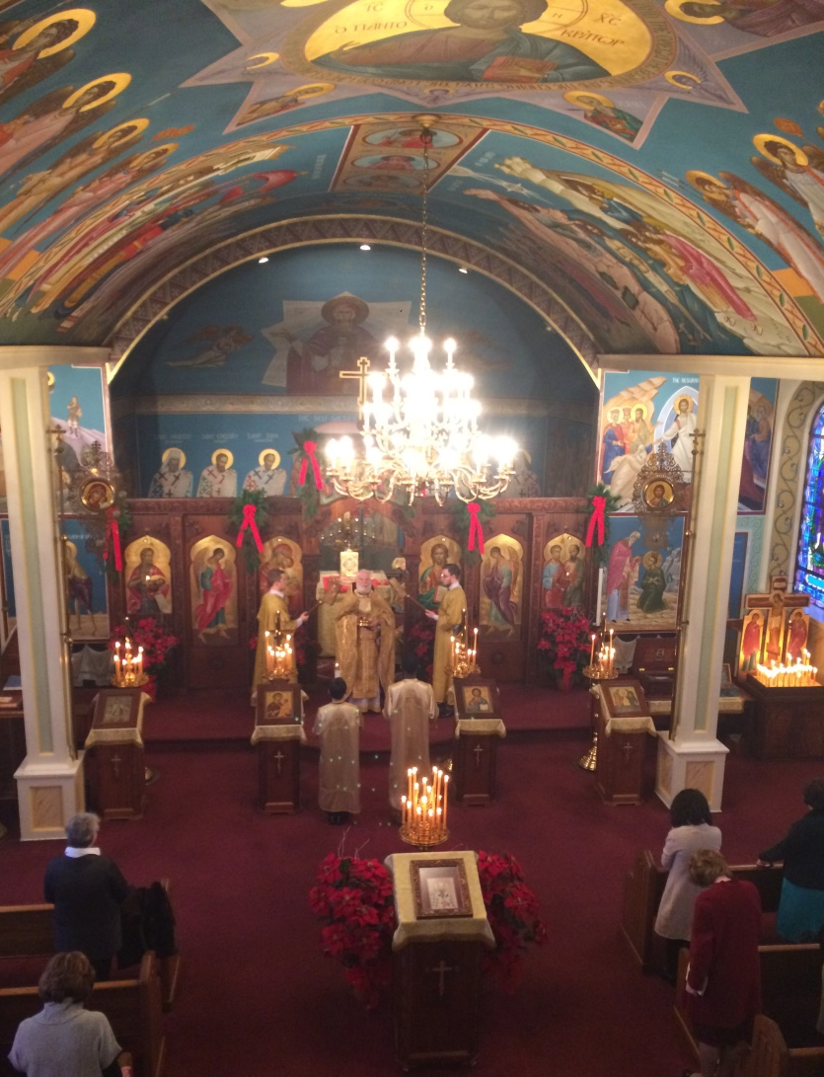
Silent Night
Silent night, holy night
All is calm, all is bright
Round yon Virgin Mother
and Child
Holy Infant so tender and mild,
Sleep in heavenly peace,
Sleep in heavenly peace.

Slide 11
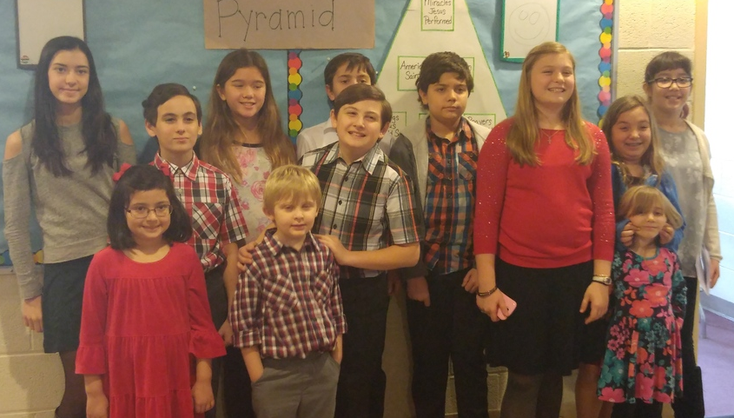
Isaac
I felt really good about that project that we did, putting together school kits for the IOCC. We made up these bags of school supplies for children all around the world and they’ll be sent to areas of need. We’re really fortunate. Could you imagine if a bag of paper, pencils, a ruler, scissors, and things like that were such a huge gift to you?
Amelia
We’re really lucky. We have everything that we need. I’m glad that our church school class could help other kids who don’t have what they need.

Slide 12
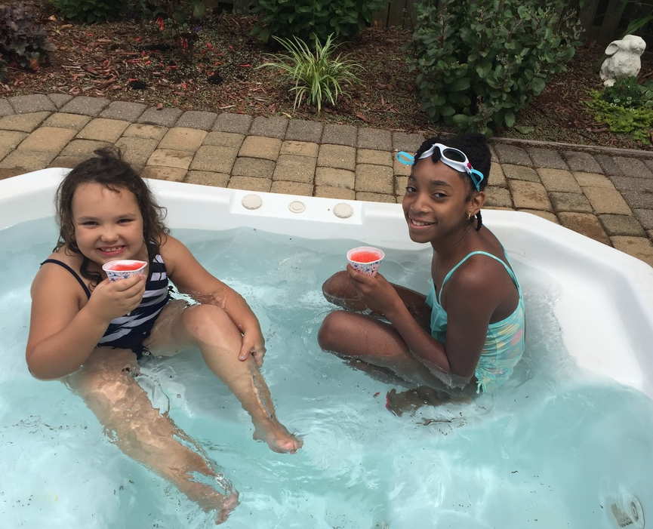
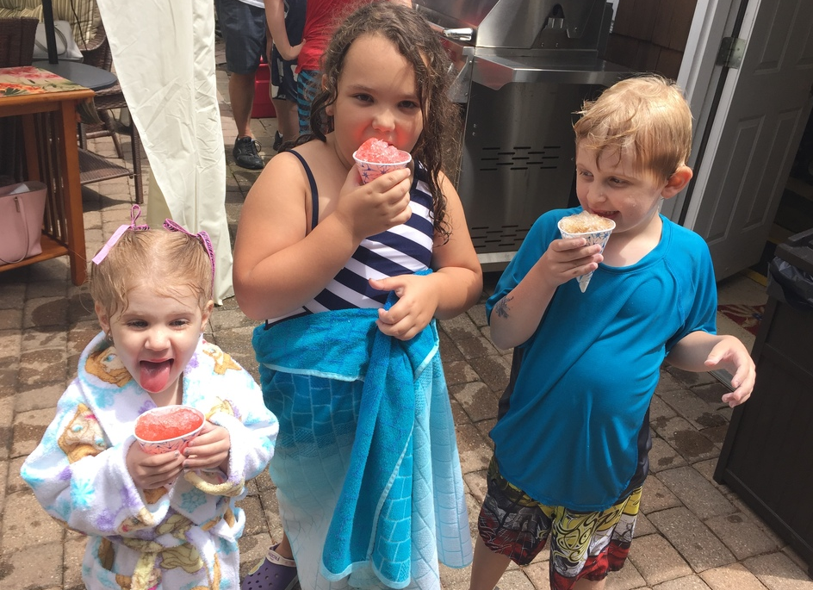
Adi
We’re also lucky because we have such good friends and we could do fun things together, like hangin’ in the hot tub at our picnic!
Heather
There’s nothing better than snow cones on a hot day – especially when you could jump back into the pool!

Slide 13
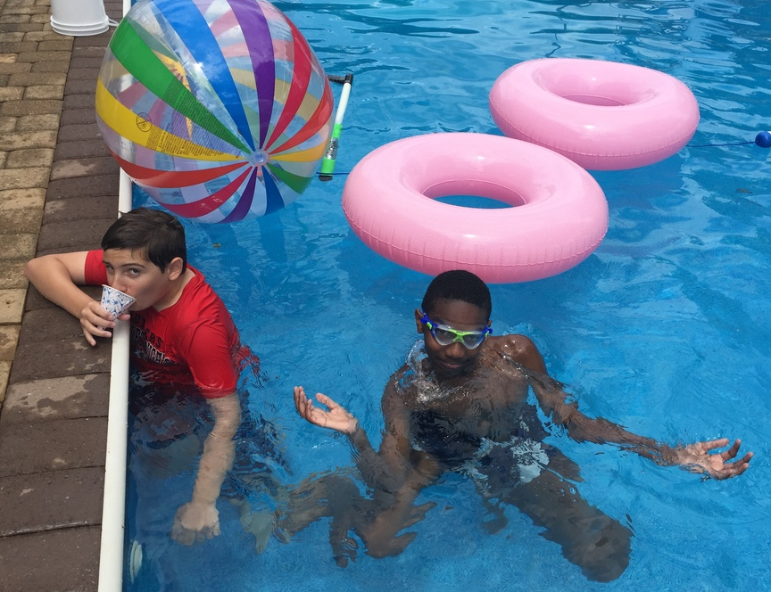
David
Yeah, I could take this – swimming, snow cones and summer! Really, though, there are great people in our parish. It’s like a big extended family and sometimes we get to just hang out and have fun.
When you’re with people who share your same values, who understand what’s really important in life, then it’s easy to just be yourself.

Slide 14
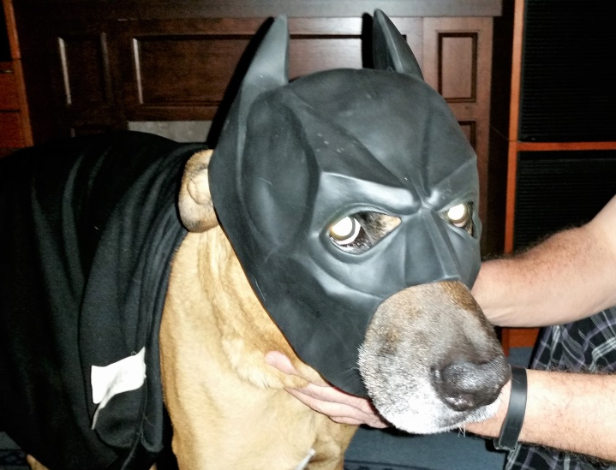
Amelia
I was reading this book about some of the saints and how they interacted with all sorts of animals – lions, bears, wild animals, farm animals, even snakes! There’s this saint named Saint Sergius of Radonezh and his story is my favorite. He lived in a cave and animals would come to visit him. There was a bear that came each day to get a treat. St. Sergius would share a piece of bread with the bear, even if he only had a very little bread for himself. The bear was even respectful! If Saint Sergius was praying, the bear would wait patiently for him to finish. I don’t think that my dog would be so patient.
Constantine
Corky thinks he’s a superhero and Amidala ALWAYS wants a treat!!

Slide 15
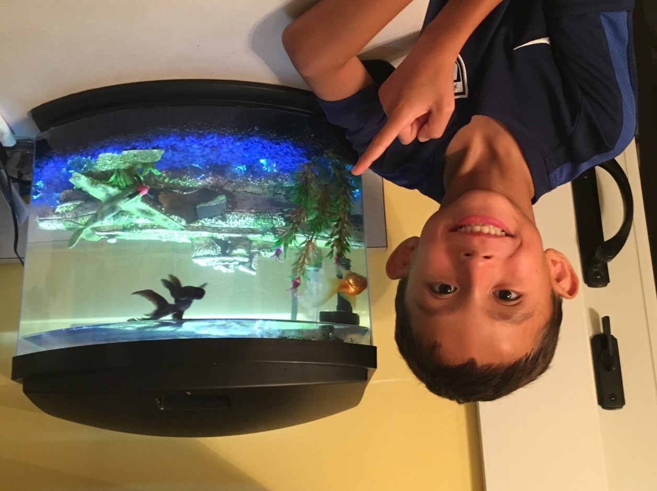
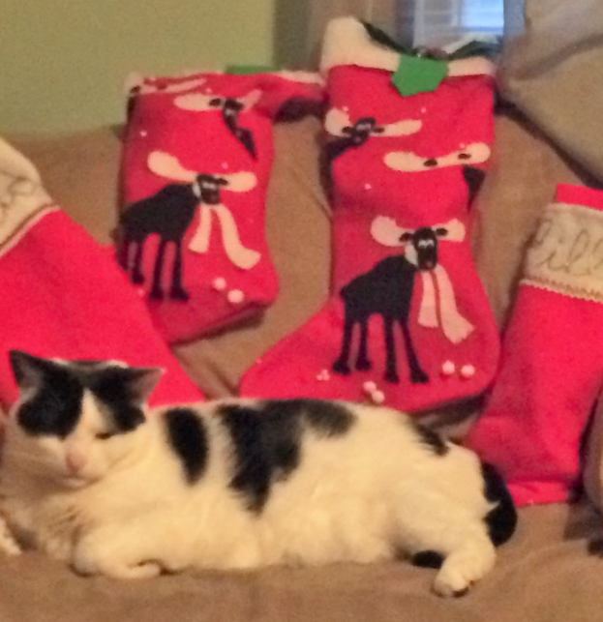
Nicholas
My fish, Flippy and Pepsi have no patience! They swim right up to the side of the tank to ASK for food!
David
Fuzzy is sooooo fat! And she was sitting guard over the Christmas stockings to make sure that she got her treat too! No patience there!

Slide 16
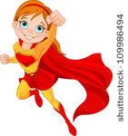
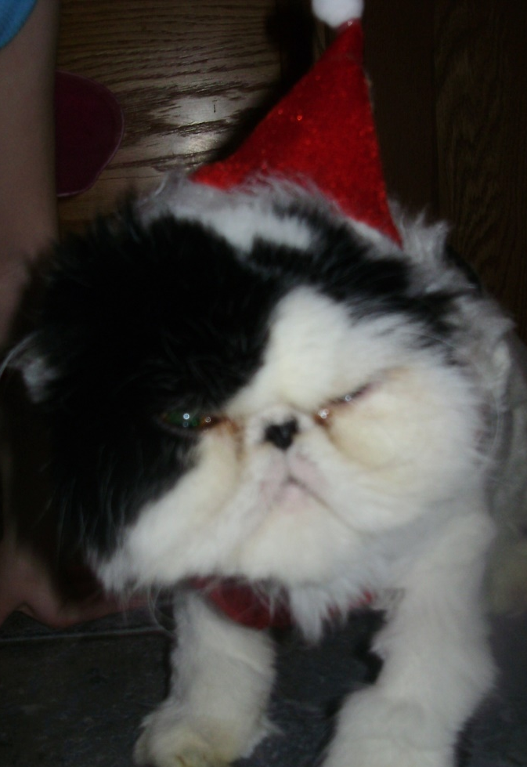
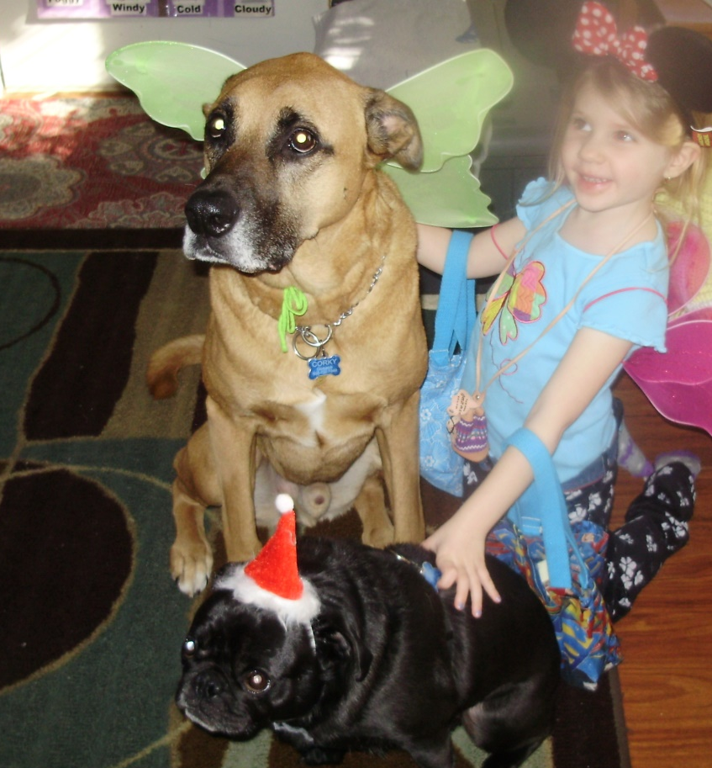
Kristabelle
Corky and Leo were having a tea party with Kristabelle. Corky was dressed as a fairy dog and Leo wore a Santa hat!
Jasper, on the other hand, wasn’t really showing too much Christmas spirit ------ and the hat didn’t help.

Slide 17
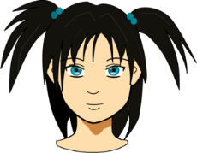
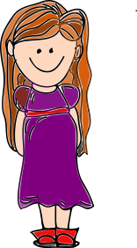
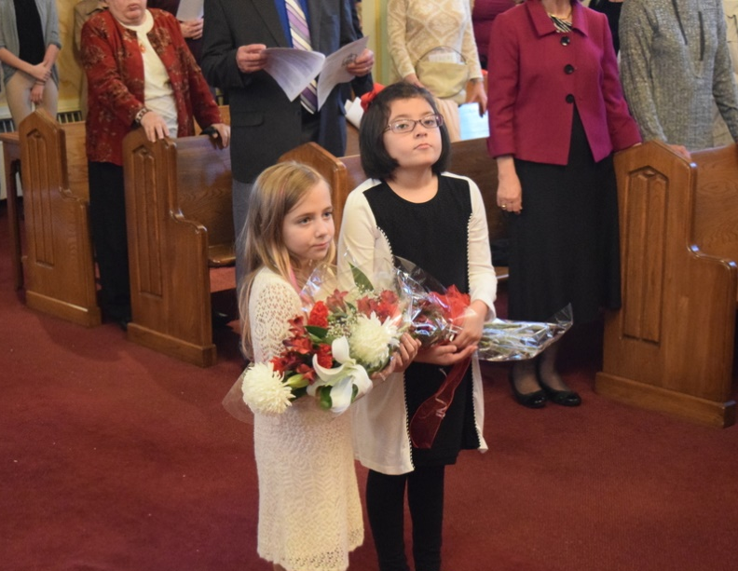
Anna
Hey out there to all of my faithbook friends! I need your prayers for a good friend who is going through a really difficult time. You know how it is – sometimes the people we love go through illnesses, sad events happen in their lives, or maybe they’re depressed. It helps so much to have the prayers of people that we know, who care about us. But it’s also good to have the prayers of all of our brothers and sisters in Christ – even if we don’t know them.
Vasilisa
I’ll pray for your friend. Sometimes we need to do something nice for people – call to say hello or maybe bring them flowers.

Slide 18
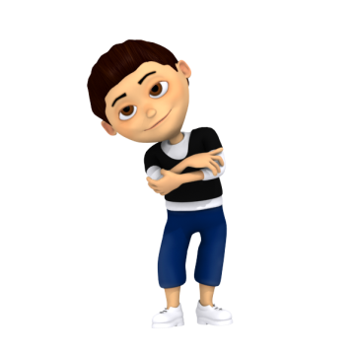
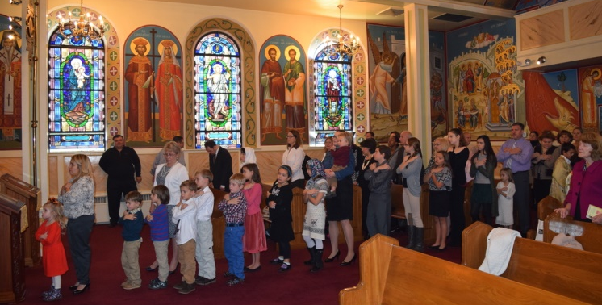
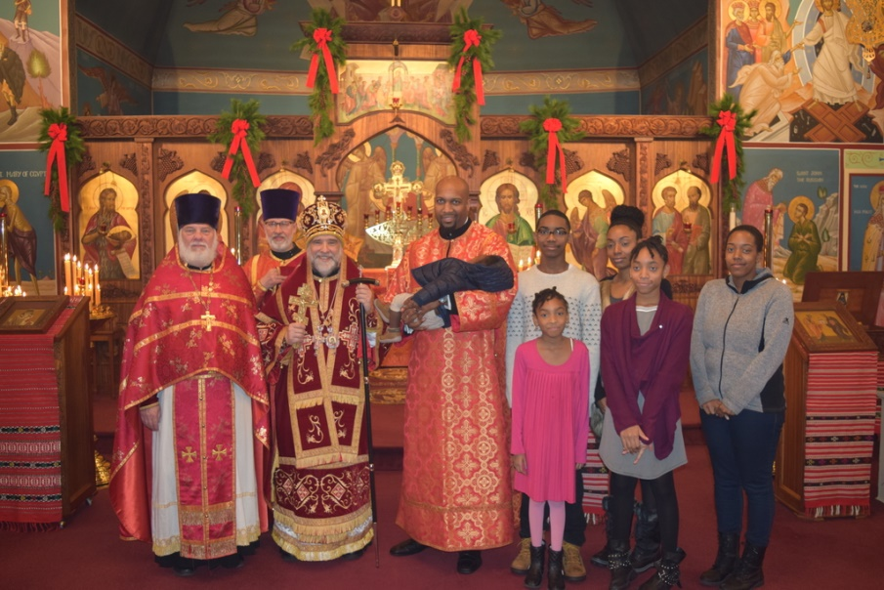
Joseph
I remember hearing that our prayers are very strong when we gather together and pray. That’s what we do each Sunday!
Morgan
I think that it’s important to pray for the people around us when they’re in need, but also when good things happen! We sort of share each other’s good times, as well as the tough times.

Slide 19
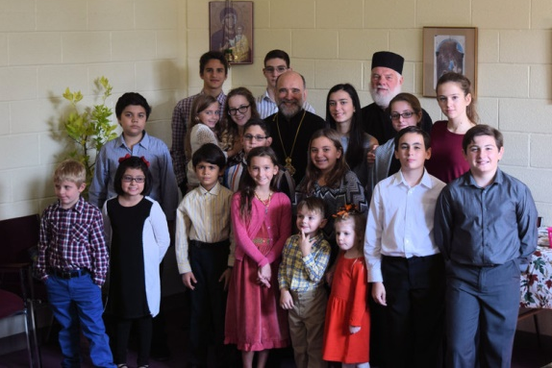
Saba
We take a lot of pictures in this church, don’t we? I guess that our parents want to keep a lot of memories.

Slide 20
The Lord’s Prayer
Our Father, Who art in Heaven
Hallowed be Thy Name
Thy kingdom come
Thy will be done on earth as it is in heaven
Give us this day our daily bread
And forgive us our trespasses,
As we forgive those who trespass against us.
And lead us not into temptation,
But deliver us from evil.

Slide 21
We hope that you enjoyed our vision of the best use of social media. While there’s not a real “faithbook”, there are many ways to connect with our fellow Orthodox Christians of all ages from around the world. Make sure that you’re a friend of Ss. Peter and Paul Orthodox Church on Facebook. Use and share your posts to bring the Good Word to the people around you! Proudly share your faith!
God bless!
Sarah

